Slide 1
Back-end programing

Slide 2
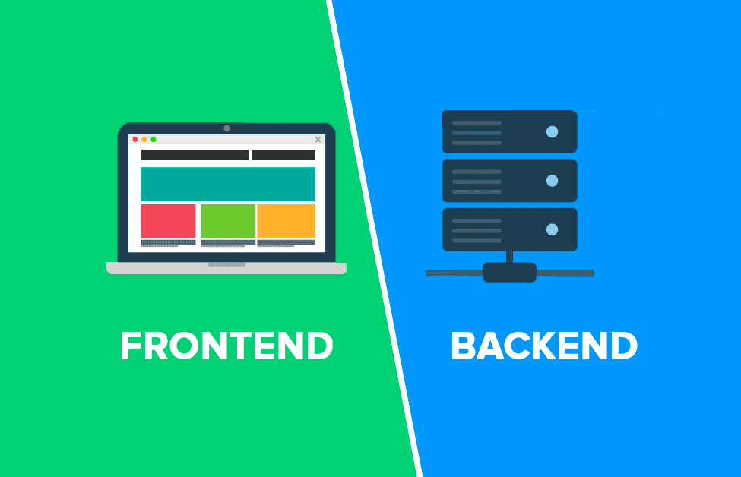

Slide 3
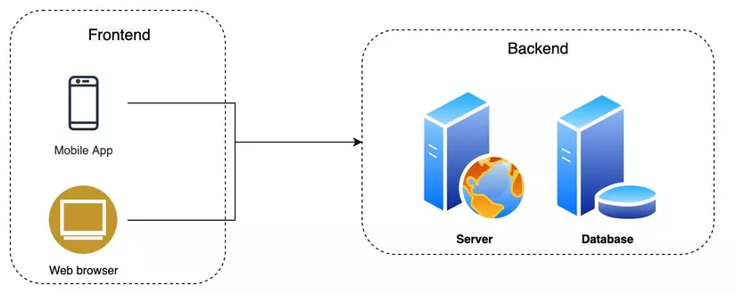

Slide 4
What is backend programing
Backend programming refers to the development of the server-side of an application
Server-side Logic – Handles requests from the front end, processes them, and sends appropriate responses.
Database Management – Stores, retrieves, and updates data efficiently.
Authentication & Security – Manages user authentication, authorization, and data security.
API Development – Allows communication between the front end, backend, and other services.
Performance Optimization – Ensures scalability and efficient processing.

Slide 5
What can we do on the Back-end?
The back-end is responsible for handling data, processing requests, managing authentication, and serving content to the front-end. In Next.js (or any backend framework), you can perform a variety of tasks:
✅ Handle API requests (GET, POST, PUT, DELETE)
✅ Connect to databases (MongoDB, MySQL, Firebase)
✅ Authenticate users (JWT, NextAuth, OAuth)
✅ Upload and store files (Cloudinary, S3, Firebase)
✅ Enable real-time communication (WebSockets, Socket.io)
✅ Automate tasks (Cron jobs, background workers)
✅ Optimize performance (Redis caching, indexing)
✅ Secure data and prevent attacks (Rate limiting, CORS)
✅ Process payments (Stripe, PayPal)
✅ Log and monitor application activity (Sentry, LogRocket)

Slide 6
What is API
An API (Application Programming Interface) is a set of rules and protocols that allow different software applications to communicate with each other.
It defines how requests and responses should be formatted so that systems can exchange data seamlessly.

Slide 7
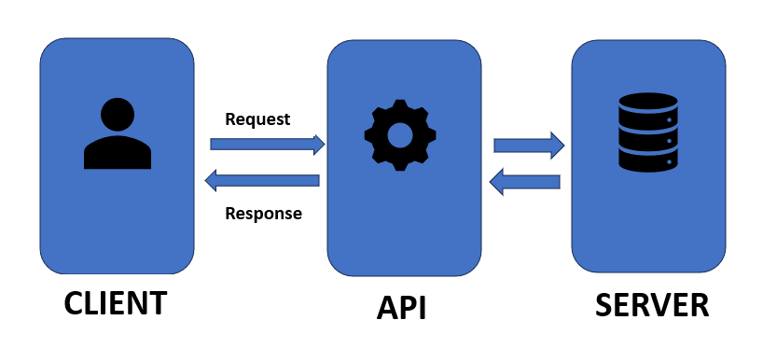
API (Cont)
Request & Response – APIs take a request from a client (e.g., a website or mobile app), process it, and return a response.

Slide 8
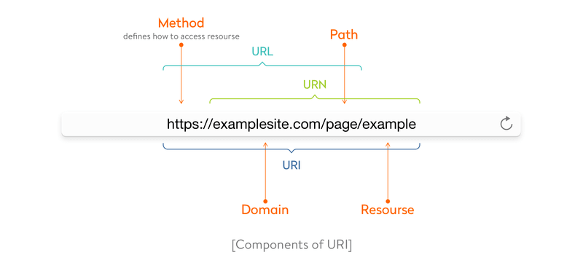
API (Cont)
Endpoints: Specific URLs that allow access to different functionalities of an API.

Slide 9
API (Cont)
Methods – Common HTTP methods used in APIs:
GET – Retrieve data
POST – Send new data
PUT/PATCH – Update existing data
DELETE – Remove data

Slide 10
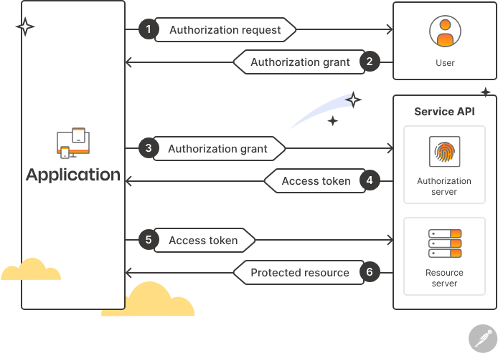
API (Cont)
Authentication – APIs may require authentication (e.g., API keys, OAuth, JWT) to ensure security.

Slide 11
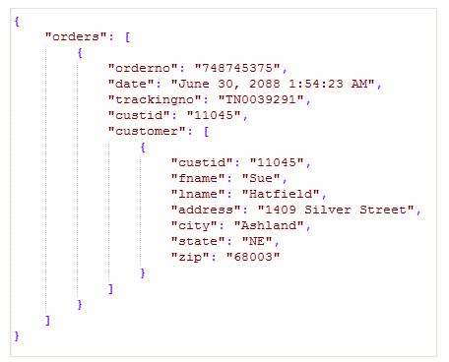
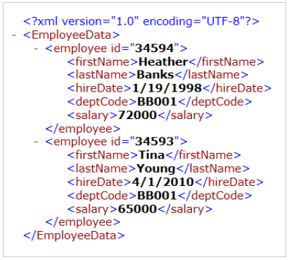
API (cont)
Data Formats – APIs commonly exchange data using JSON or XML.

Slide 12
Types of APIs
REST API (Representational State Transfer) – The most common type, using standard HTTP methods.
GraphQL – A flexible query language that allows clients to request specific data.
SOAP API – Uses XML-based messaging (older but still in use for enterprise applications).
WebSockets API – Enables real-time, two-way communication (used for chat apps, live notifications, etc.).

Slide 13

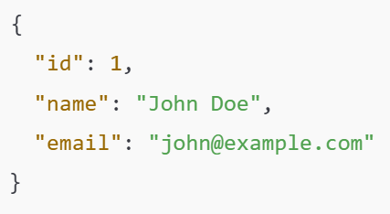
Example
Example of a Simple API Request (REST API in JSON format)
A request to get user data:
Response:

Slide 14
Why (and when) to build API
Public API for Multiple Clients: You can build a public API that’s consumed by your web app, a separate mobile app, or any third-party service.
Proxy to an Existing Backend: Sometimes you want to hide or consolidate external microservices behind a single endpoint. API can act as a proxy or middle layer to another existing backend. For instance, you might intercept requests, handle authentication, transform data, and then pass the request along to an upstream API.
Webhooks and Integrations: If you receive external callbacks or webhooks (e.g., from Stripe, GitHub, Twilio), you can handle them with API.
Custom Authentication: If you need sessions, tokens, or other auth logic, you can store cookies, read headers, and respond with the appropriate data.

Slide 15
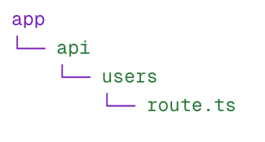

Next.js - Create an API
In the App Router (app/), create a folder that represents your route, and inside it, a route.ts file.

Slide 16
Next.js - working with API (code example)
Directly using Request & Response
Query parameters
Headers and cookies
https://nextjs.org/blog/building-apis-with-nextjs#4-working-with-web-apis

Slide 17
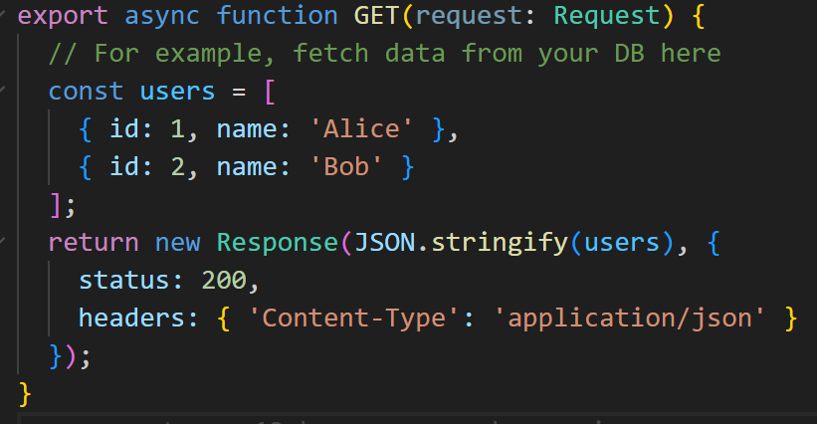
Next.js - working with API (code example)
Directly using Request & Response
By default, your Route Handler methods (GET, POST, etc.) receive a standard Request object, and you must return a standard Response object.
Example: react-demo/api/users/route.ts

Slide 18


Next.js - working with API (Query parameters)
What is Query parameters? Also known as URL parameters or query strings, are key-value pairs appended to a URL after a question mark (?), used to pass additional information to a web server, like filtering or sorting content
Ex: api/queryParam

Slide 19
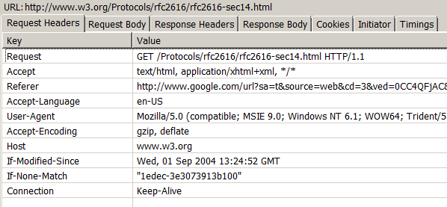
Next.js - working with API (Header)
Example: api/headerAndCookie
A request header is a section of an HTTP request that provides metadata about the request, allowing the server to understand the context and tailor its response accordingly
Purpose:
Request headers contain key-value pairs that provide additional information about the request, such as the client's browser, the type of data being sent, and the desired response format

Slide 20
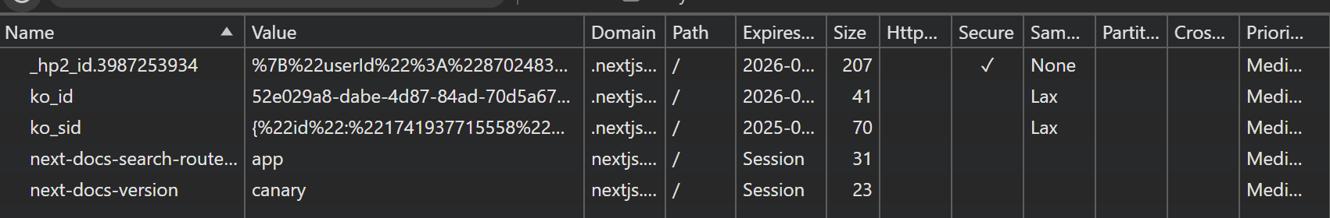
Next.js - working with API (Cookies)
What is cookies:
Cookies are small files of data, typically containing letters and numbers, that a website stores on your device when you visit it.

Slide 21
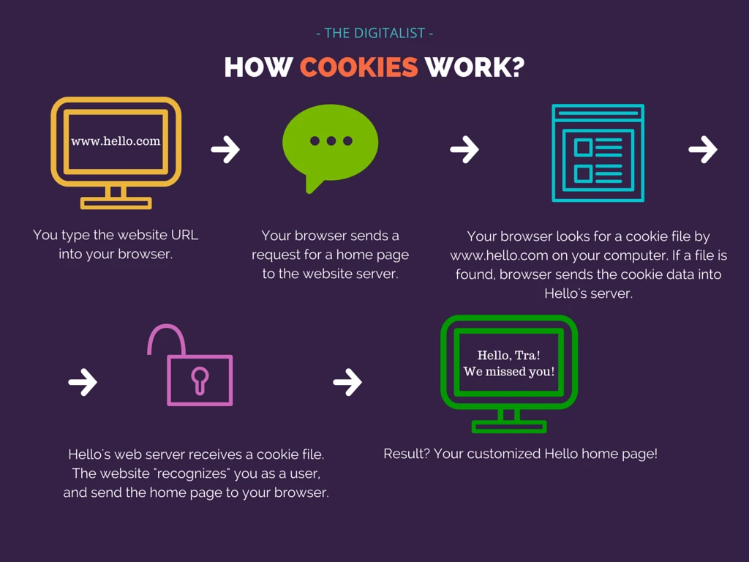
Next.js - working with API (Cookies)
How they work:
When you visit a website, it can send a cookie to your browser, which then stores it on your device. When you revisit the website, your browser sends the cookie back to the server, allowing the website to recognize you and access the stored information.

Slide 22
Next.js - working with API (Cookies)
Example: headerAndCookie
What they do:
Remembering your preferences: Cookies can store information about your language, theme, or other settings, so the website can remember these preferences for future visits.
Keeping you logged in: They can store login information, so you don't have to log in every time you visit a website.
Tracking your activity: Some cookies track your browsing behavior to personalize content or display targeted ads.
Enabling shopping carts: They can store items in your online shopping cart, so you can complete your purchase later.
Types of cookies:
First-party cookies: Set by the website you are visiting.
Third-party cookies: Set by a different domain than the one you are visiting, often used for advertising or tracking.

Slide 23
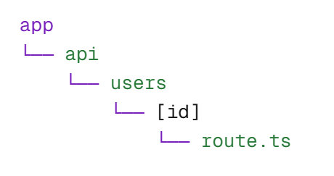


Next.js - working with API (Dynamic routes)
Example: api/user/[id]

Slide 24
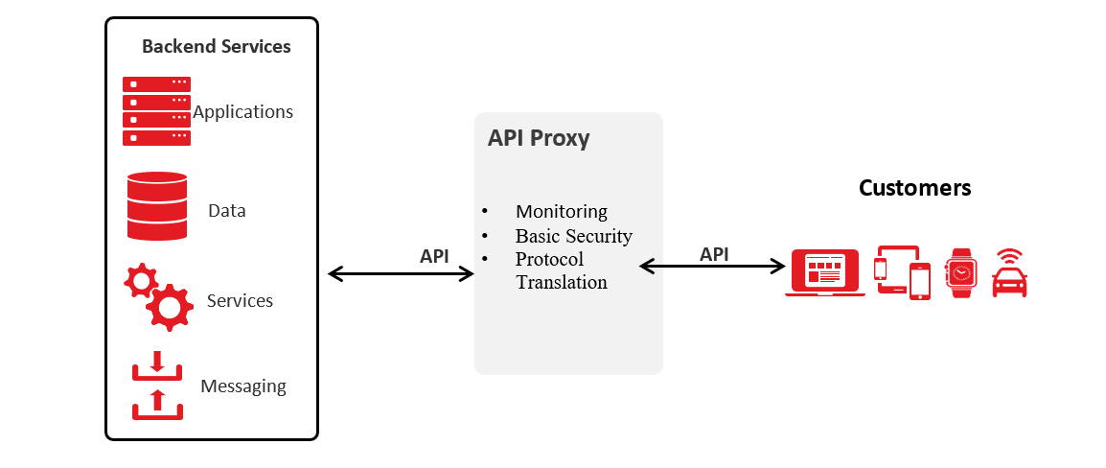
Next.js - working with API (Proxy or Forwarding layer)
example:api/proxy

Slide 25
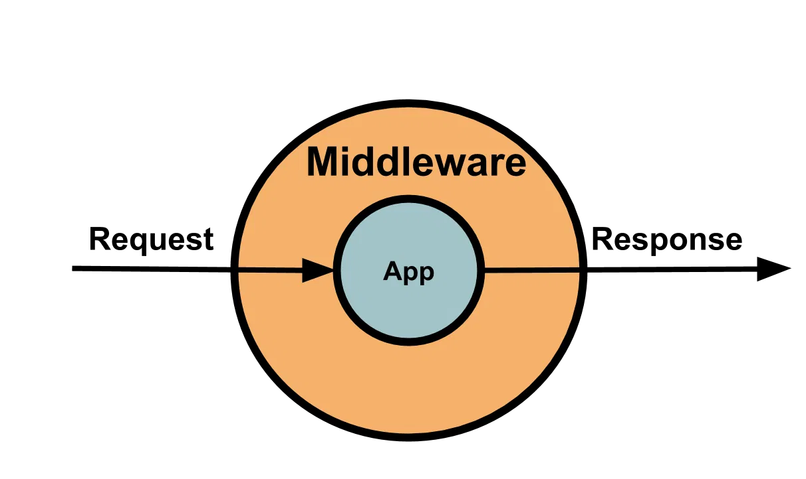
Next.js - working with API (building middleware)

Slide 26
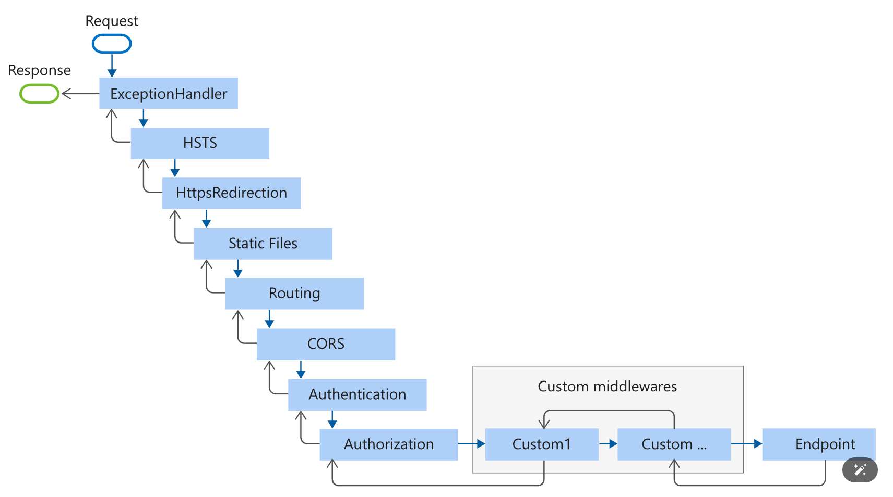
Next.js - working with API (building middleware)
Example: react-demo/api/middleware

Slide 27
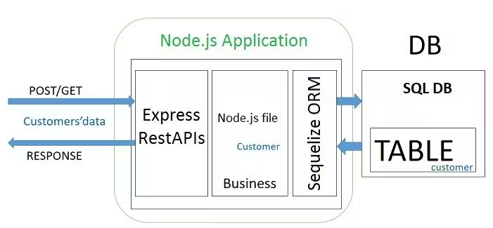
Connect to Databases

Slide 28
Database types
Relational Databases (SQL): Examples include MySQL, PostgreSQL, and SQLite. These databases store data in structured tables, and you query them using SQL (Structured Query Language).
Non-relational Databases (NoSQL): Examples include MongoDB, Azure Cosmos, Firebase, Cassandra, and Redis. These databases are often more flexible, handling unstructured or semi-structured data in formats like documents, key-value pairs, or graphs.

Slide 29
Steps to Connect to a Database
Install Database Client/Driver
To interact with the database, you need a specific client or driver for your chosen database.
For example:
In Node.js, you might use mysql2 for MySQL or mongoose for MongoDB.
In Python, you might use psycopg2 for PostgreSQL or PyMongo for MongoDB.
In Java, you'd use JDBC (Java Database Connectivity) for SQL-based databases.

Slide 30
Steps to Connect to a Database (cont)
Database Configuration
You will need to configure your database connection settings, which typically include:
Host: The database server’s address (could be a local address like localhost or a remote server).
Port: The port the database is running on (e.g., MySQL commonly runs on port 3306).
Username: The user account for accessing the database.
Password: The password for the given user account.
Database name: The specific database you want to connect to on the server.

Slide 31
Steps to Connect to a Database(cont)
Create Connection: Once the database client/driver is installed and configured, you can initiate a connection using code
Handle Queries: Once the connection is established, you can perform various SQL or NoSQL queries to interact with the data. (INSERT, UPDATE, DELETE, SELECT).
Closing the Connection: After performing your operations, you should always properly close the connection to the database to prevent unnecessary resource usage.

Slide 32
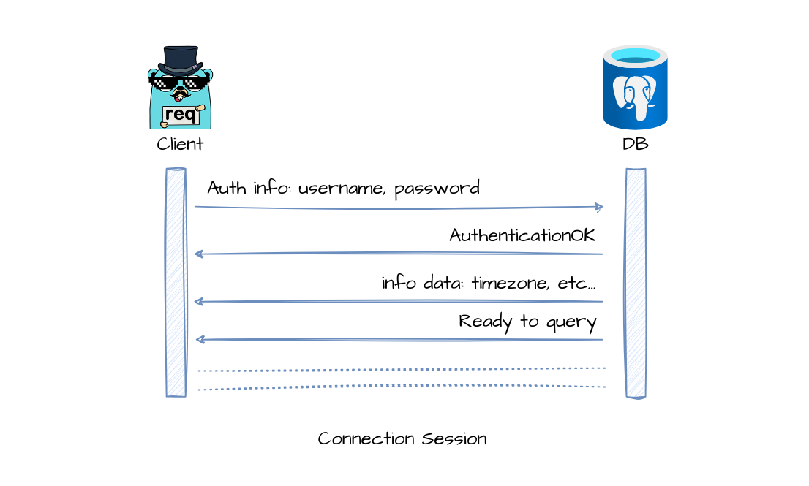
Steps to connect Database

Slide 33
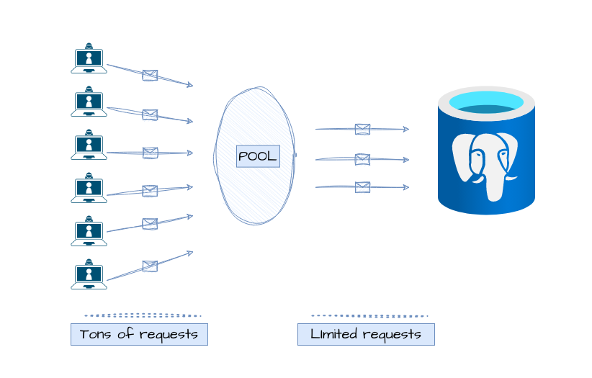
Connect to DB (cont)
Connection Pools: For production applications, it’s common to use a connection pool to manage database connections efficiently. A connection pool keeps a set of pre-established connections ready to be reused, improving performance by reducing the overhead of repeatedly opening and closing database connections.

Slide 34
Connect to DB (Cont)
Security Considerations:
When connecting to a database, always consider security:
Environment Variables: Store sensitive information (e.g., passwords, API keys) in environment variables, not hardcoded in your codebase.
Encryption: Ensure that sensitive data like passwords is encrypted, both in transit (via SSL/TLS) and at rest in the database.
SQL Injection: Prevent SQL injection attacks by using parameterized queries or prepared statements.

Slide 35
Connect to DB (Cont)
Error Handling: Always handle potential connection errors gracefully. Ensure that your application can recover from database connection issues, and log appropriate error messages to debug any issues.

Slide 36
Connect to DB (Cont)
Connect to MSSQL in Next.js
Ex: api/connectDb

Slide 37
Authenticate Users
The process of verifying the identity of users before granting access to certain resources or actions in an application.
It ensures that only authorized users can interact with your application in ways that are permitted.
Authentication is typically done through a series of steps where the server validates a user's identity based on credentials (like a username and password)

Slide 38
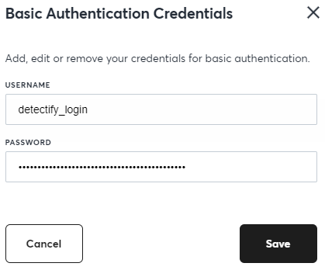
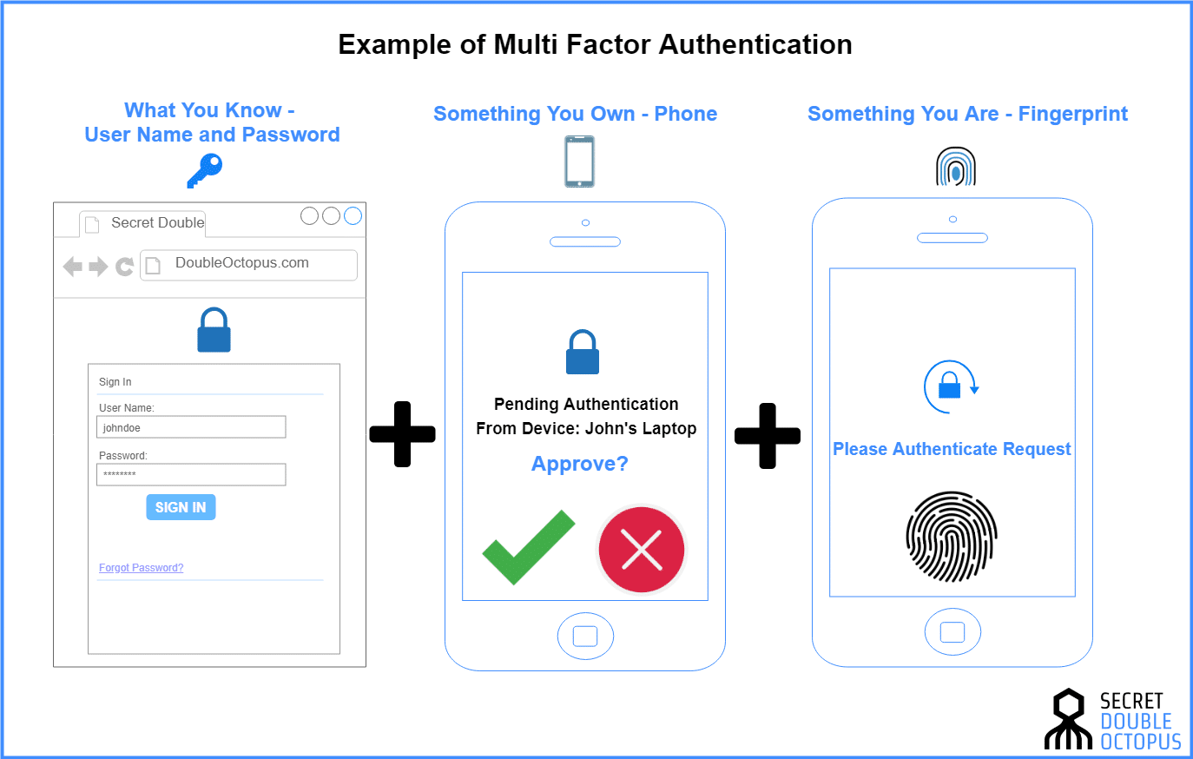
Key Concepts in Authentication
1. Credentials:
Username/Password: The most common form of authentication, where users provide a username and password to verify their identity.
Multi-factor Authentication (MFA): Adds an extra layer of security by requiring additional forms of verification, such as a one-time passcode sent to a phone or generated by an authenticator app.

Slide 39
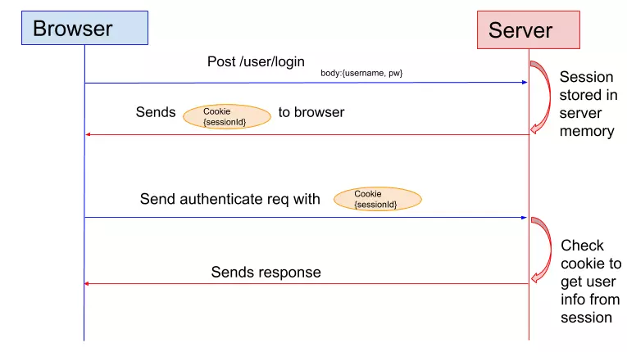
Key Concepts in Authentication
2.Sessions: After a user is authenticated, a session is typically created that allows them to interact with the application without needing to re-authenticate repeatedly. Sessions are usually managed using a session ID stored on the client side (often in cookies) and validated on the server side.

Slide 40
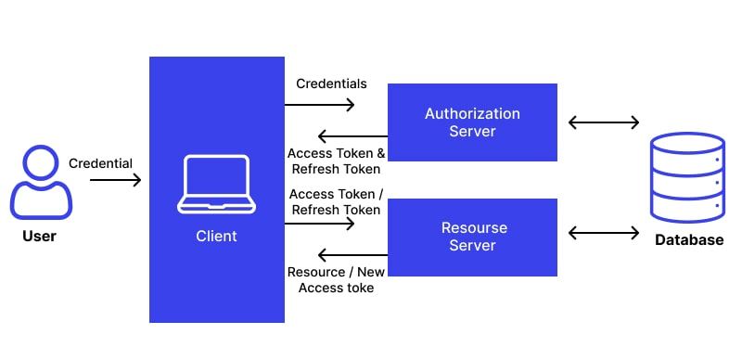
Key Concepts in Authentication
3.Tokens: Modern applications often use tokens for authentication, especially in APIs and distributed systems. Tokens like JWT (JSON Web Tokens) are a popular choice, where the server issues a token after user authentication, and the client sends it in subsequent requests for verification.

Slide 41
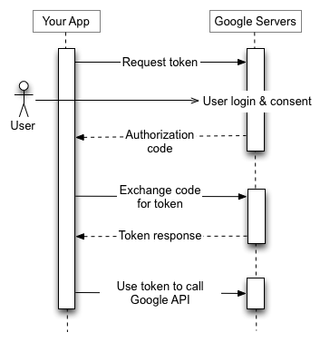
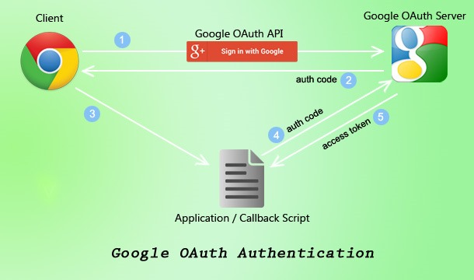
Key Concepts in Authentication
4.OAuth & OpenID Connect: These are common protocols for delegated authentication. Instead of creating a new login system, you can authenticate users via external providers (like Google, Facebook, or GitHub). These protocols allow the server to trust another entity (the third-party provider) to authenticate the user.

